Slide 1
TEENAGE PREGNANCY

Slide 2
WHY WE CHOOSE THIS TOPIC?
We choose the Topic Teenage Pregnancy so that we can get lessons that we can apply to ourselves until now, and also to keep in mind that not everything happens in a hurry.
That everything should be thought carefully before doing something that you know you will regret in the end.

Slide 3
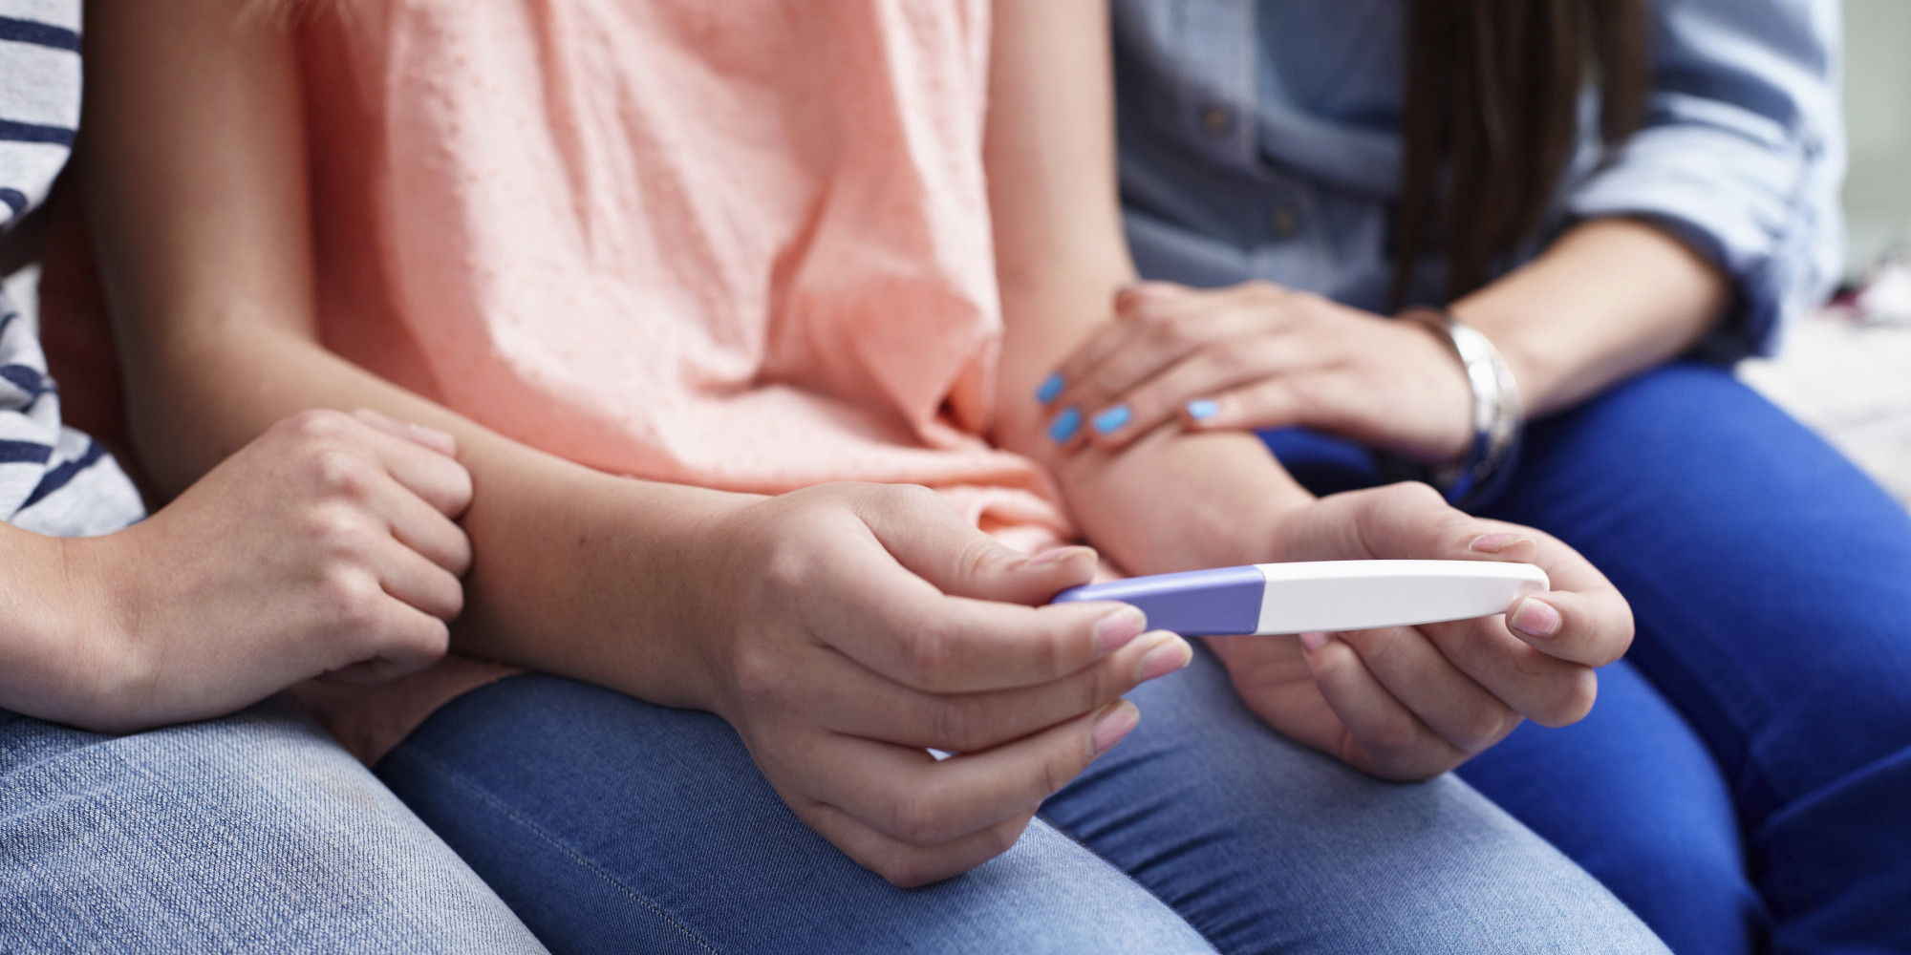
PREGNANCY
Pregnancy among adolescents in Latin America and the Caribbean has become a critical issue, posing significant medical and psychosocial risks.
Younger mothers are at a higher risk of developing obstetric fistula, anemia, eclampsia, postpartum haemorhage, and puerperal endometritis.

Slide 4
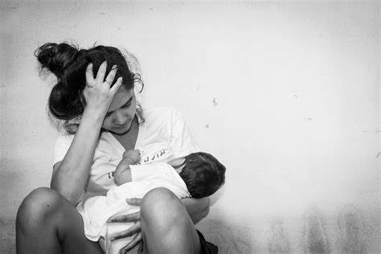
TEEN AGE PREGNANCY
elated death is the second leading cause of death after accidents among adolescents 15 to 19 years of age.
Teenage motherhood is often seen as a step towards adulthood, but it is often linked to sexual violence and pregnancy.
Despite a decline in fertility in the region, adolescents who have unwanted pregnancies are often denied rights and limited access to health services, information, and sex education.

Slide 5
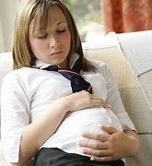
Despite a decline in fertility in the region, adolescents who have unwanted pregnancies are often denied rights and limited access to health services, information, and sex education.
In Latin America, rural areas have a higher prevalence of child marriage, particularly among Indigenous adolescents, contributing to intergenerational poverty.

Slide 6
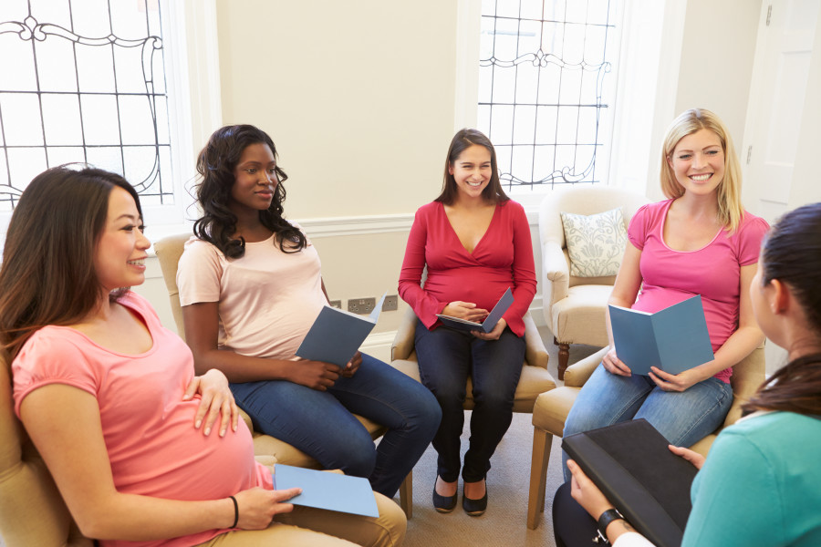
GROUP LEARNED ABOUT TEENAGE PREGNANCY.
a significant issue affecting females under twenty, causing verpopulation, medical risks, prenatal care, and decreased female education.
To prevent teen pregnancy, we discussed strategies like television programs, fundraising, club support, sexual education, and therapists for pregnant teenagers.

Slide 7
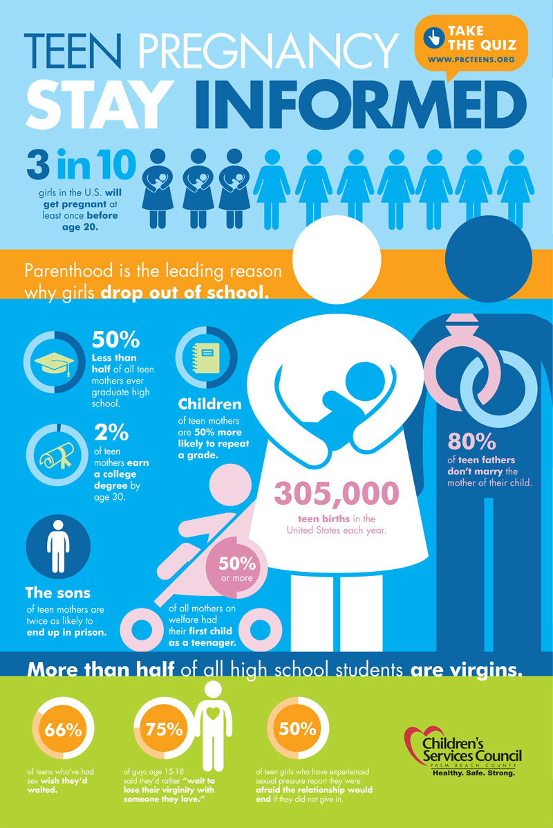
IMPORTANT LESSON
is the huge change that could open your eyes to other aspects of living and life.
pregnancy isn't easy for everyone especially to those teenagers whose already pregnant.
learning to protect yourself is really important you should learn about things before something started to happen and then everything will be to late too turn back.

Slide 8
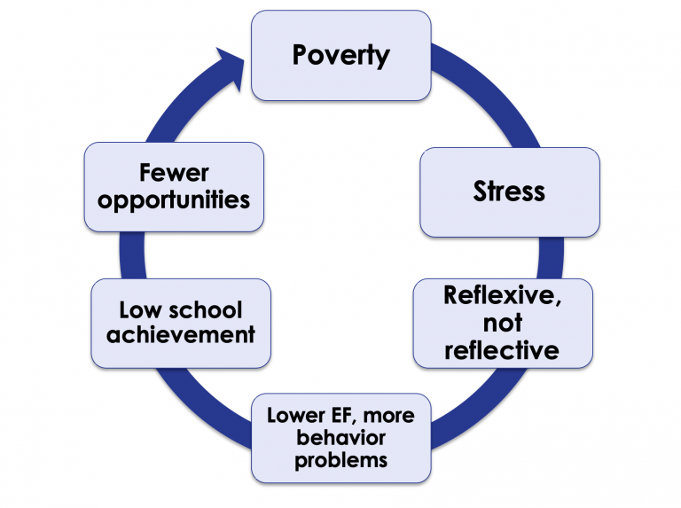
MORAL LESSON
is never let yourself to loose and explore more that can put you up in this situation.
Don't Start rebelling once more and learn to cope up with having a blessed baby.

Slide 9
NAME OF MEMBERS
REGINE MACALLAN
JOAN QUIRRE
ROBERT FERNANDEZ

